Slide 1
Organisational design
Structures, types of structures, impact of different structures on business efficiency and motivation

Slide 2
What are organisational structures?
The structure in which the positions within the business are arranged is often know as the internal structure or the formal organisational structure of the business.
Workforce roles are defined
Route through which decisions are made
Who is responsible? and who is accountable?
Structure helps businesses divide work and coordinate activities to achieve objectives.

Slide 3
Organisational chart example
General manager
Booking and administration
Theatre maintenance
Production liaison
Marketing

Slide 4
Hierarchy
The order or the level of responsibility in an organisation, from the lowest to the highest.
Some businesses produce oragnisational charts and they show:
Business split into departments and divisions
Roles of employees and job titles
To whom people are accountable
Communication channels
Relationships between the different positions in the business

Slide 5
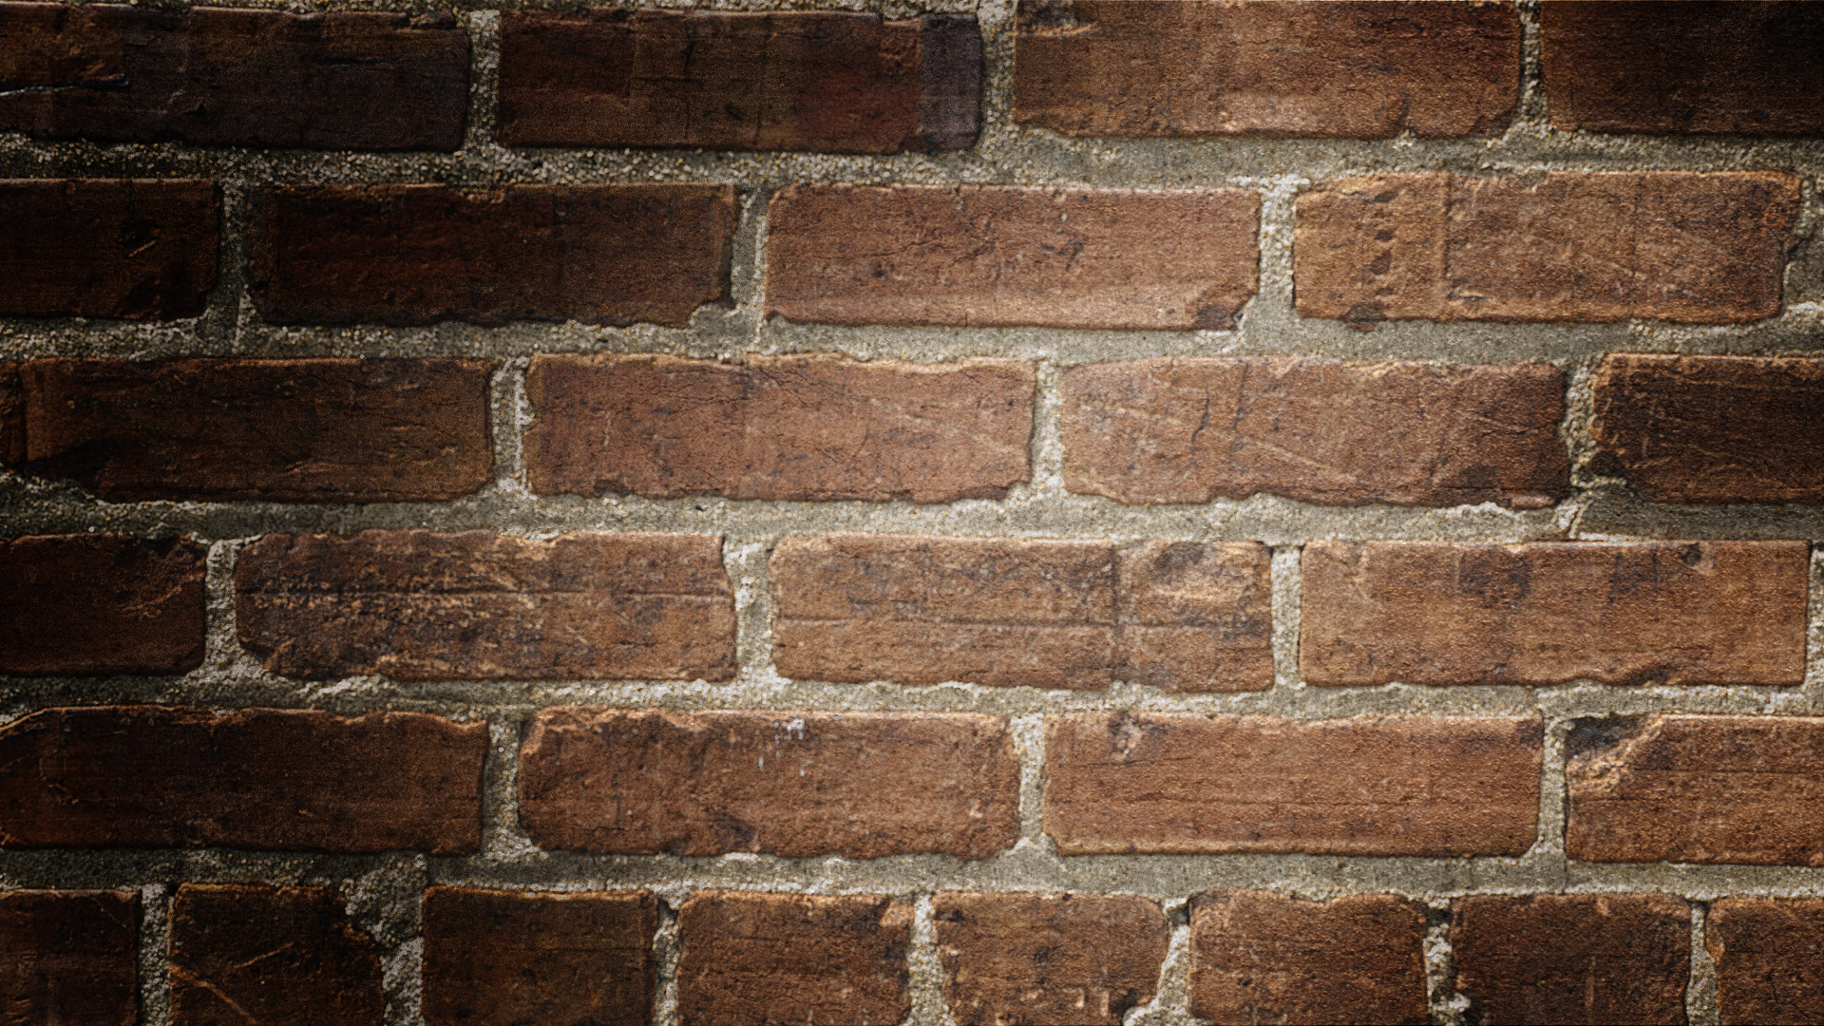

Slide 6
Employee roles in the organisational hierarchy
Directors ( hired to run the business in interest of owners)
Mangers (controlling and organising within the business)
Team leaders (resolve issues between teams or coordinate them)
Supervisors (hire, discipline, promote, punish, reward)
Professionals (decision-making or responsibility)
Operatives (skilled workers)
General staff (follow instructions and are important part operations)

Slide 7
Chain of command
The way authority is organised – chain of command

Slide 8
Span of control
The number of people, or subordinates, a person directly controls in a business is called the span of control.
For example: if the production manager has ten subordinates, then the span of control is 10.

Slide 9
Authority and responsibility

Slide 10
Centralisation and decentralisation
They both refer to the extent of authority within the delegations of a business.
Complete centralisation would be where subordinates have no authority at all.
Complete decentralisation would be where subordinates have all the authority.
There Should be a balance.

Slide 11
Advantages
Centralisation
Decentralisation

Slide 12
Types of organisational structures
Tall structures
Flat sturcures
Long chain of command but narrow span of control.

Slide 13
Types of organisational structures
Matrix structures
Allows businesses to connect people with specialist skills and bring them together to create a project team.

