Slide 1
Critical Path Analysis
A Level Business Tutor
Chapter 55 Edexcel A Level Business
A-Level Business: Chapter 55 Theme 3

Slide 2
Learning objectives
A Level Business Tutor
Chapter 55 Edexcel A Level Business
What is CPA?
EST, EFT, LST, LFT
Float
Fill the network diagram
Forward & Backward Passes

Slide 3
What is CPA?
A Level Business Tutor
Chapter 55 Edexcel A Level Business
CPA is a project management tool that identifies the sequence of key tasks and the longest path to project completion.
Helps in efficient project planning, resource allocation, and identifying potential delays.

Slide 4
Example
A Level Business Tutor
Chapter 55 Edexcel A Level Business
Tasks and Durations For Launching a new product
Task | Duration (Days) | Predecessor(s)
Market Research | 5 | None
Product Design | 10 | Market Research
Prototype Development | 8 | Product Design
Marketing Plan | 6 | Prototype Development
Production | 12 | Marketing Plan

Slide 6
Calculating EST, EFT, LST, LFT, and Float:
EST (Earliest Start Time): The earliest time an activity can begin.
EFT (Earliest Finish Time): EST + Activity Duration
LST (Latest Start Time): The latest time an activity can start without delaying the project.
LFT (Latest Finish Time): The latest time an activity can be completed without delaying the project.
Float (Total Float): The amount of time an activity can be delayed without delaying the project.
Free Float: The amount of time an activity can be delayed without delaying the start of any subsequent activity.

Slide 7
Calculating EST, EFT, LST, LFT, and Float:
EST (Earliest Start Time): The earliest time an activity can begin.
For the first activity: EST = 0 (Project start)
For subsequent activities: EST = EFT of the preceding activity.
EFT (Earliest Finish Time): EST + Activity Duration
LST (Latest Start Time): The latest time an activity can start without delaying the project.
For the last activity: LST = LFT (Latest Finish Time)
For preceding activities: LST = LFT - Activity Duration
LFT (Latest Finish Time): The latest time an activity can be completed without delaying the project.
For the last activity: LFT = EFT (Earliest Finish Time) of the last activity (project end date).
For preceding activities: LFT = LST of the immediately following activity.
Float (Total Float): The amount of time an activity can be delayed without delaying the project.
Float = LST - EST
Free Float: The amount of time an activity can be delayed without delaying the start of any subsequent activity.
Free Float = EFT of the preceding activity - EST of the current activity

Slide 8
Calculations
Forward Pass
Backward Pass
Task | Duration (Days) | EST | EFT | LST | LFT | Total Float | Free Float
Market Research | 2 | 0 | 2 | 0 | 2 | 0 | 0
Product Design | 3 | 2 | 5 | 2 | 5 | 0 | 0
Prototype Development | 3 | 5 | 8 | 5 | 8 | 0 | 0
Marketing Plan | 4 | 2 | 6 | 4 | 8 | 2 | 2
Production | 2 | 8 | 10 | 8 | 10 | 0 | 0

Slide 9
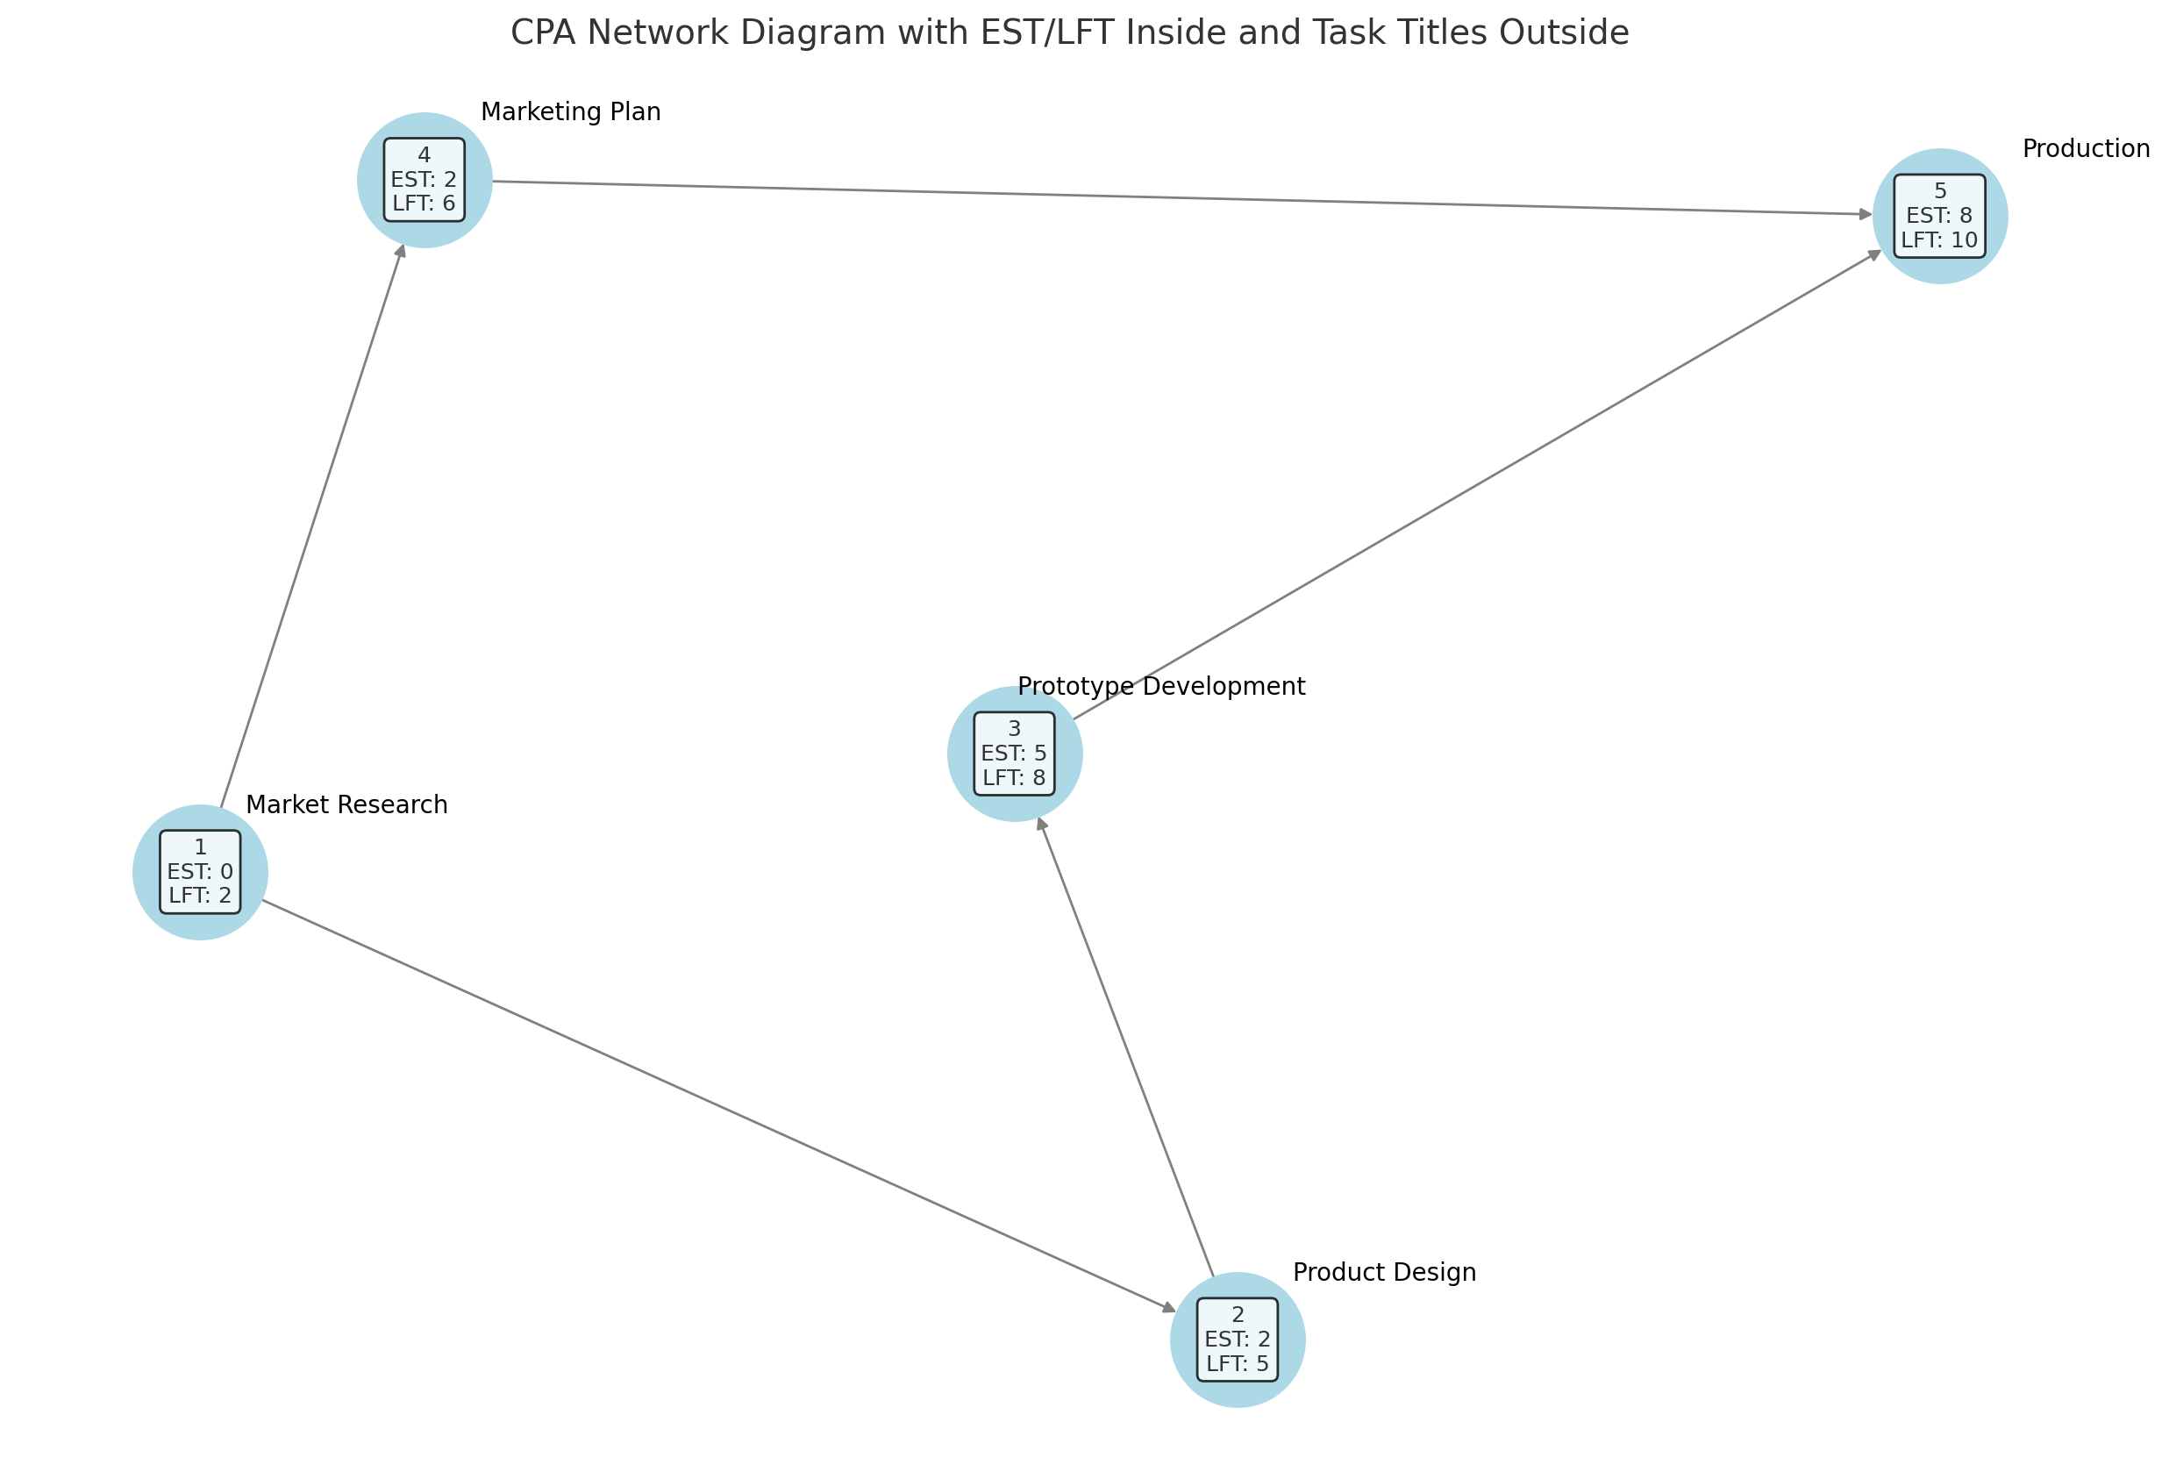

Slide 10
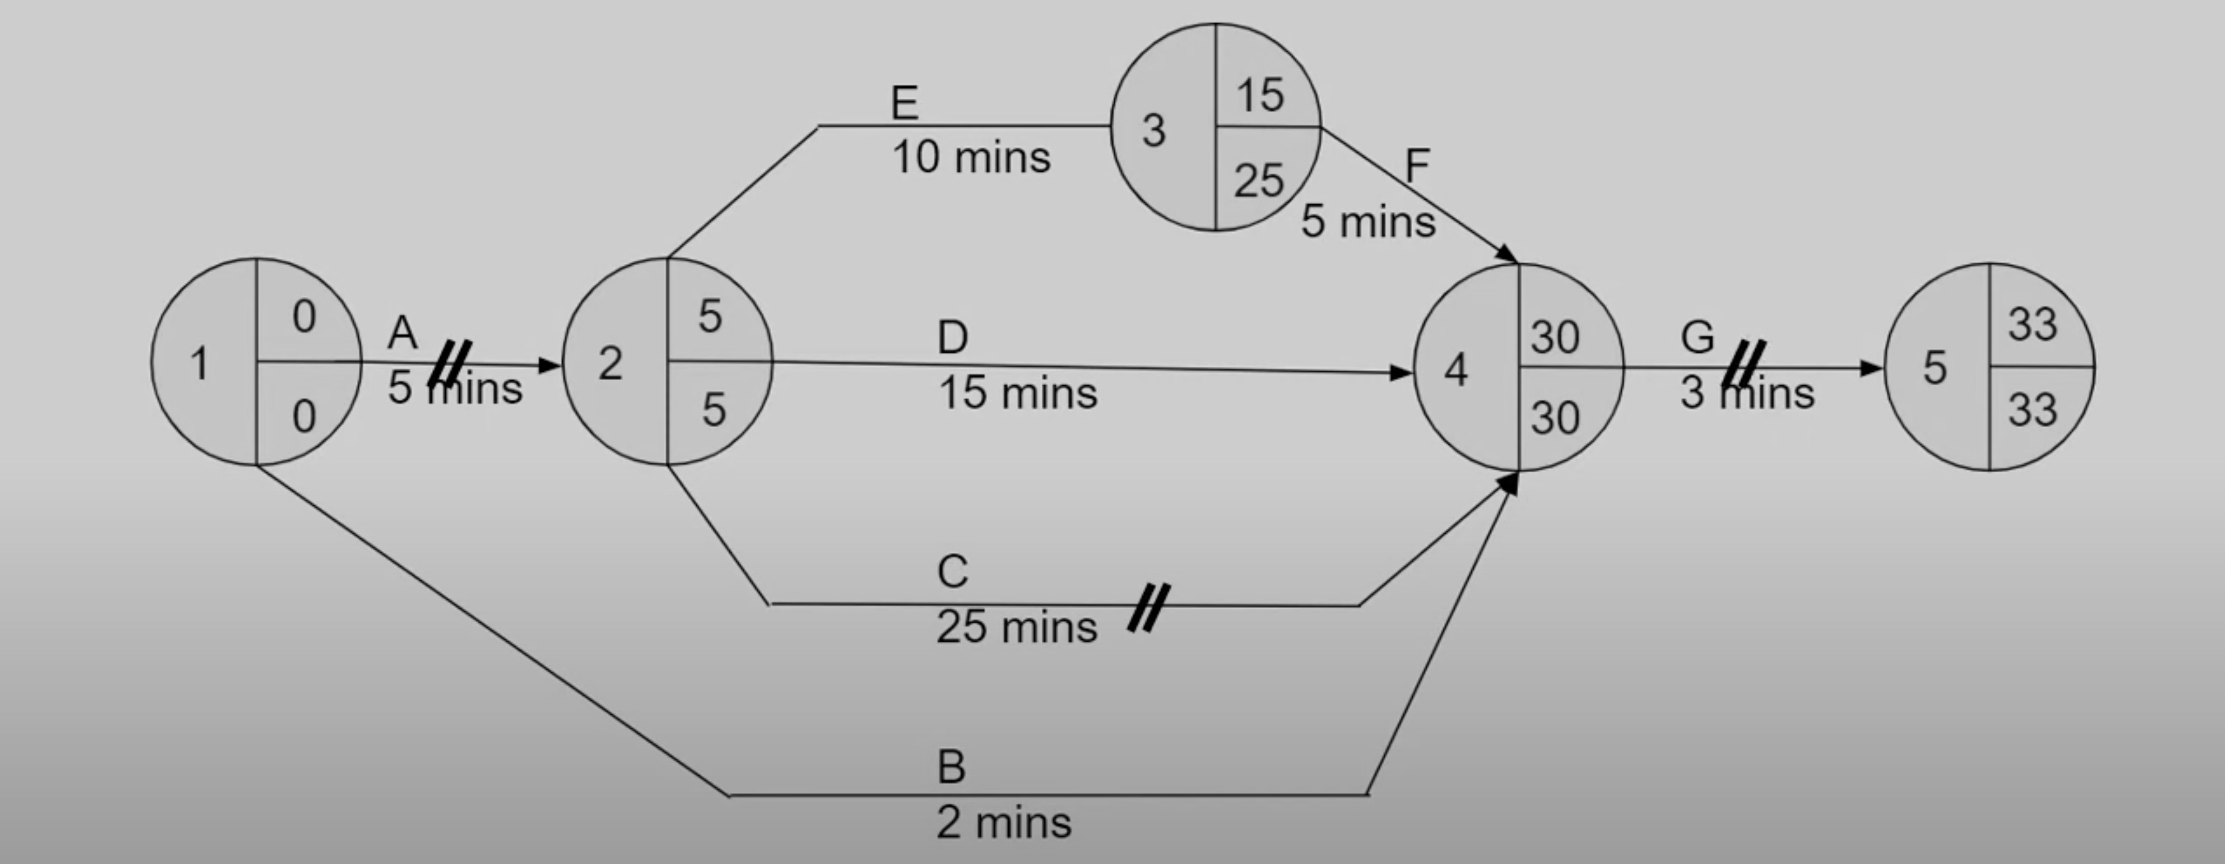
Forward Pass

Slide 11
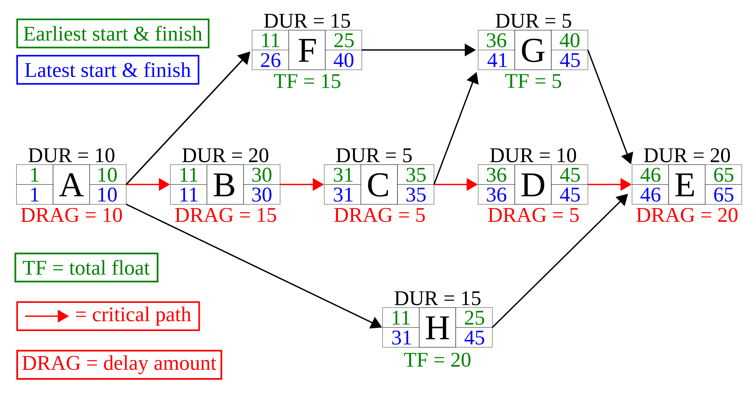

Slide 12
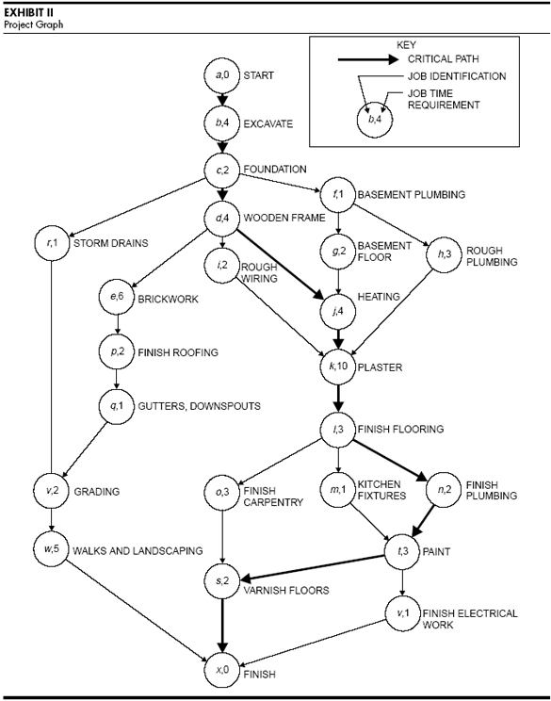

Slide 13
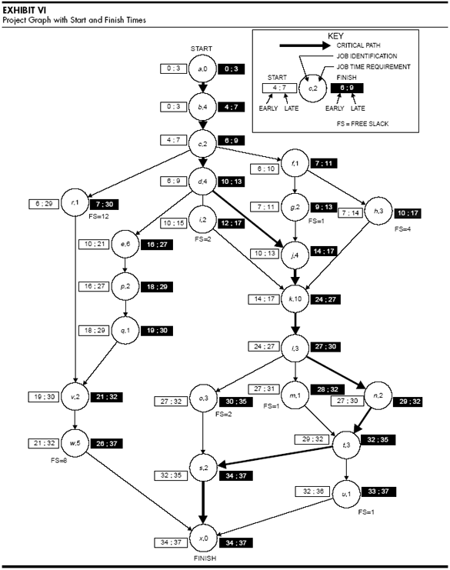

Slide 14
How to calculate EFT?
A Level Business Tutor
Chapter 55 Edexcel A Level Business
The Earliest Finish Time of a task is the earliest time that the task can be completed, considering the task’s Earliest Start Time (EST) and its duration.
Calculation:
EFT= EST+ Duration of Task
The EFT shows when a task can finish at the earliest, assuming that all predecessor tasks have been completed on time.
Notes:
Task 1 (Node 1):
It starts first, so EST = 0.
Duration = 5 days
Task 1 finishes at 0 + 5 = 5 days.
Task 2 (Node 2):
Task 2 depends on Task 1, so it can only start after Task 1 finishes.
EST of Task 2 = EST of Task 1 + Duration of Task 1 = 0 + 5 = 5 days
Duration = 15 days
Task 2 finishes at 5 + 15 = 20 days.
Task 3 (Node 3):
Task 3 depends on Task 2, so it starts after Task 2 finishes.
EST of Task 3 = EST of Task 2 + Duration of Task 2 = 5 + 15 = 20 days
Duration = 23 days
Task 3 finishes at 20 + 23 = 43 days.
Task 4 (Node 4):
Task 4 depends on Task 3, so it starts after Task 3 finishes.
EST of Task 4 = EST of Task 3 + Duration of Task 3 = 20 + 23 = 43 days
Duration = 29 days
Task 4 finishes at 43 + 29 = 72 days.
Task 5 (Node 5):
Task 5 depends on Task 4, so it starts after Task 4 finishes.
EST of Task 5 = EST of Task 4 + Duration of Task 4 = 43 + 29 = 72 days
Duration = 41 days
Task 5 finishes at 72 + 41 = 113 days.

Slide 15
How to Calculate LFT?
A Level Business Tutor
Chapter 55 Edexcel A Level Business
The Latest Finish Time of a task is the latest time that the task can be completed without delaying the project.
It is part of the critical path method (CPM) and helps identify how late a task can be finished without affecting the overall project completion date.
Calculation:
LFT=LST of Successor Task−Duration of Task
The LFT is determined by working backward from the project’s end date or the finish times of dependent tasks. It tells us the latest possible finish time for a task that still allows for the project to finish on schedule.

Slide 16
How to calculate Total Float?
A Level Business Tutor
Chapter 55 Edexcel A Level Business
Total Float=LFT−EFT
OR
Total Float=LST−EST
OR
LFT – EST – Duration

Slide 17
How to calculate Free Float?
A Level Business Tutor
Chapter 55 Edexcel A Level Business
EST start of next task – EST start of this task– duration

