Slide 1
Product/service design
Key points are:
The design mix , (function, aesthetics, cost)
Changes to the elements of design mix

Slide 2
What is the design mix? Why is it important?
When designing a product, number things are considered and they make up the design mix.
To help the businesses create quality products for their customers, the tool design mix is essential.
The process of creating a new product or service is called product design.
Designers use something called a design brief to work on various products.
The design mix consists of 3 main components called function, aesthetics and cost.

Slide 3
Below is a diagram showing the design mix:
Function
Cost
Aesthetics

Slide 4
Function: purpose or job of the product
It should work properly and carry out whatever task the customer purchased it to do.
For example: a printer should print documents smoothly and to good quality.
Businesses selling printer may offer a long warranty on their printer (product) to show their customers that they have full confidence in that product works and is very durable.
Products that don’t work are likely to be returned and this costs the business money. It will add to the business costs.

Slide 5
Ergonomically designed products
What does ergonomically mean?
Ergonomics is the study of how people interact with their environment and equipment that they use – often in the workplace.
Products that are ergonomically designed are ones that optimise human well-being.
An example could be office equipment such as an office chair or ergonomic chair.
There are 5 aspects of ergonomic: safety, comfort, ease of use, productivity/performance, aesthetics.

Slide 6
Ergonomically designed products
Designers must make sure that new products are safe.
Safety is highly important if the products are going to be used by children, the elderly and pregnant women.
If the business can design a product which functions better than other products on the market then that is their USP or unique selling point.
USP helps businesses get a competitive advantage.

Slide 7
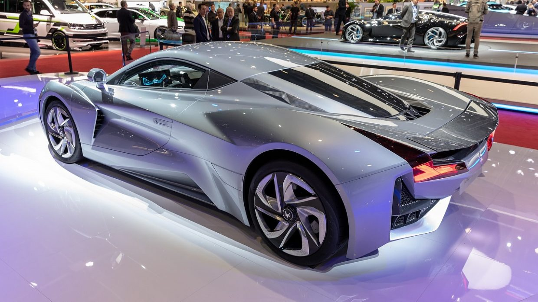
Luxury cars

Slide 8
Aesthetics
Products should have a visual appeal as well as performing a function to a high quality. That is the products’ aesthetic appeals.
Products’ shapes, sizes, smells and presentation should be take into account when designing and creating a product.
Example: luxury cars have leather that smells nice or expensive perfumes have a stronger and nicer scent.
As cost comes down over time in manufacturing, aesthetics will likely become more important.

Slide 9
Cost
Producers/business have to make sure to design the product in a way in which it is cost efficient.
Designers need to select materials which minimise costs.
A well designed product is more likely to be economically viable.
This means a business should be able to make a profit after selling that product.
Businesses often have to reach a compromise between design and cost. (in any industry; aviation, space, automobiles)

Slide 10
The design of various products might take into account different elements of the design mix
Functionality may be important for products such as tools, machines, exercise equipment etc.
Aesthetics might be important for makeup products or clothes, carpets, wall paper or luxury goods etc.
Cost may be important for services such home insurance or car insurance.

Slide 11
The design mix – affects of social trends on it
People are aware of their activities hurting the environment like global warming, resource depletion and pollution.
People have been encouraged by online/social media to use environmentally friendly products.
Businesses have responded to pressure from the government, media and consumer groups to take into account the environmental issues in the designs of their products.
The designs may attempt to re-use materials or use recyclable materials for products or packaging.

Slide 12
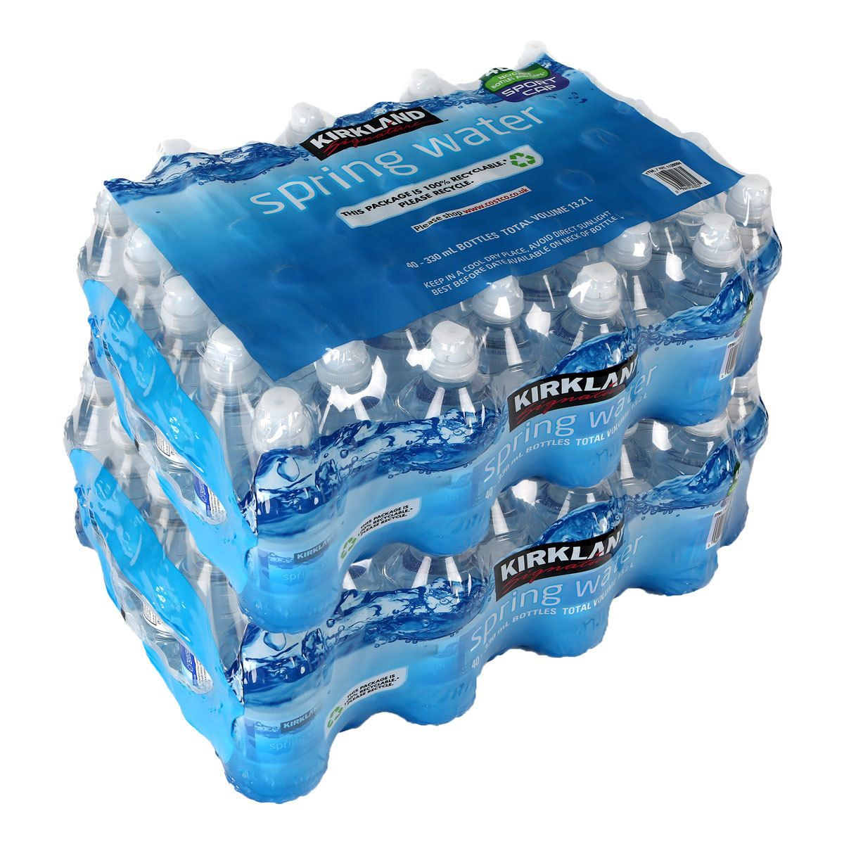
Costco water bottles

Slide 13
Designing your products for waste minimisation
Firms are under increasing pressure to design products which minimise waste.
Pressure groups?
Make products which are more durable by adding components that can be repaired easily.
Make products lighter or smaller to help reduce materials used in production and ease of packaging and distribution.
Try not to produce disposable products. Scope here?

Slide 14
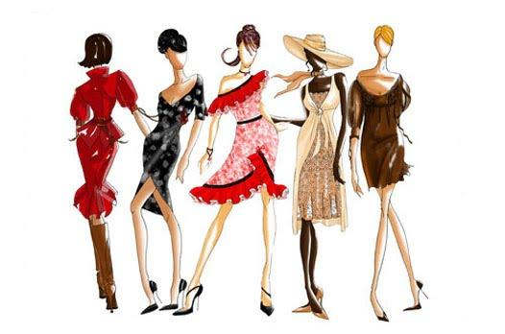
Fashion industry – radical change needed in social trends, new season so old clothes – still functional – but tossed aside

Slide 15
Other ways to design products that are environmentally friendly or ethical
Design products for re-use (that can be repaired)
Design products for recycling (materials that can be recycled like glass manufacturers use long used glass to make new glass)
In media, it may be possible to recycle content or material to save time and effort.
Ethical sourcing: using materials, components and services from suppliers that respect the environment, treat their workforce well and generally work with integrity.
Recycling: making use of materials that are regarded as waste.

Slide 16
Benefits of making products that meet the social trends
Although, designing products that are environmentally friendly might be costly, the businesses can reduce waste and this means they use less resources which lowers costs and increases profit in the long run.
Design that reflect social trends will be more popular and sell more which will increase sales revenue and improve profits.
Designing products in this way will help a business gain their USP as well. Ecover (non-chemical cleaners)
This gives them chance to be regarded as good corporate citizens and can market that are socially responsible which helps them increase profitability.

