Slide 1
Demand & Supply – a level business
Factors affecting demand
Factors affecting supply

Slide 2
Definitions
Demand is the quantity of a product which a consumer is willing and able to buy/purchase for a given price.
Supply is the quantity of a product for which a supplier is willing and able to purchase for a given price.
Complementary goods: goods that are purchased and consumed together.
Inferior goods: goods for which demand will fall if income rises, or rise if income falls
Normal goods: demand will rise if income increases, demand falls when income falls.
Substitute goods: goods that can be bought as an alternative to others, but perform the same function.

Slide 3
Demand diagram
Price
P1
D1
Q1
Quantity

Slide 4
Supply diagram
Price
S1
P1
Q1
Quantity

Slide 5
Definitions
Subsidy: a grant given to businesses usually to encourage the production of a good.
Supply curve: a line drawn on a graph that shows how much of a good sellers are willing to supply at different prices.

Slide 6
The interaction of supply and demand
When the supply and demand are equal, the price is called the equilibrium price.
This price is also called the market clearing price.
Formula
Total revenue = price x quantity
Changes in demand can occur as price increases, demand will decrease.
Changes in supply can occur, as the price increases, demand will increase.

Slide 7
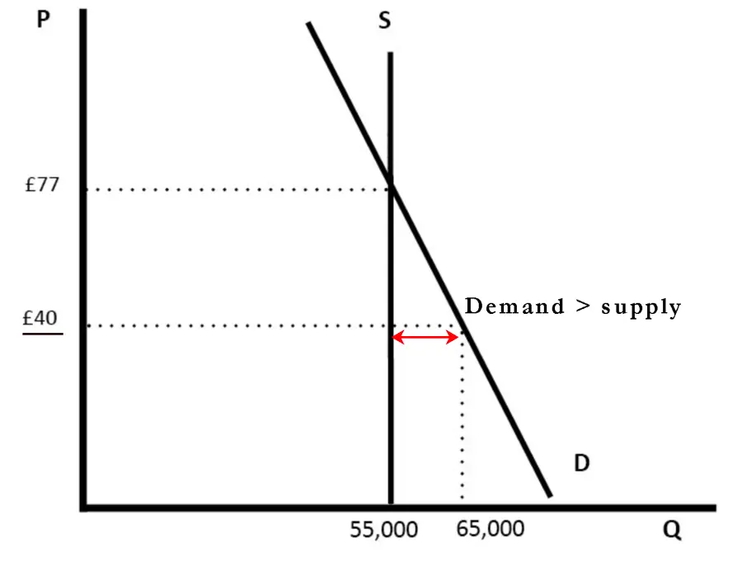
Disequilibrium of the market
Market is in disequilibrium when there is excess demand or excess supply.

Slide 8
PED or price elasticity of demand.
Price elasticity of demand (PED) measures the responsiveness of demand after a change in price.
https://www.economicshelp.org/wp-content/uploads/2012/11/income-elasticity-explained.png

Slide 9
Interpretation of numerical values of price elasticity of demand.
Price elasticity | Value of elasticity | Price change | Effect on total revenue
Inelastic | Less than 1 | decrease | Falls
Inelastic | Less than 1 | increase | Rises
Elastic | Greater than 1 | Decrease | Rises
Elastic | Greater than 1 | Increase | Falls
Inelastic demand product
Price increases by 15%
Demand falls _ by how much? That will determine whether the business rev. will go up or down?
Demand fall by 10%

Slide 10
The factors influencing price elasticity of demand or PED
Time (for example price for petrol falls by 20% this week, demand is likely to fall by only a few percent because people use their cars to carry out tasks every single day to go to work, buy groceries etc.
Competition for the same product (when there are perfect substitutes for example farmers)
Branding (Apple, Samsung, Nokia)
The proportion of income spent on a product (less income spent on a product, demand is likely to be inelastic)
Location (hotels with great views)

Slide 11
YED or income elasticity of demand
Income elasticity of demand (YED) measures the responsiveness of demand to a change in income.
https://www.economicshelp.org/wp-content/uploads/2012/11/income-elasticity-explained.png

Slide 12
Source https://www.economicshelp.org/wp-content/uploads/2012/11/income-elasticity-explained.png

Slide 13
Examples of goods with different YED
Good | Income elasticity | Elastic or Inelastic | Type of good | The effect of a 10% increase in income
Product W | 0.6 | Inelastic | Normal | Demand would increase by 6%
Product X | -2.4 | Elastic | Inferior | Demand would fall by 24%
Product Y | 1.9 | Elastic | Normal | Demand would rise by 19%
Product Z | -0.8 | Inelastic | Inferior | Demand would fall by 8%

Slide 14
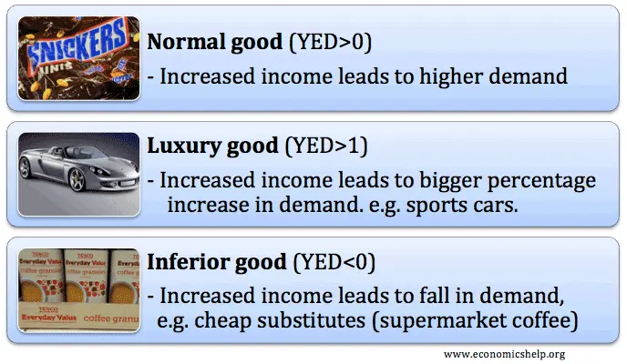
Using knowledge of income elasticity of demand
Firms will make use of income elasticity of demand by producing more luxury goods during periods of economic growth.
In a recession with falling incomes, supermarkets might be advised to promote more ‘value’ inferior goods.

